Slide 1
Civility in the Global Village
Ashley Horst Executive Director
Stubblefield Institute for Civil Political Communications
October 5, 2022

Slide 2
What is civility?
The quality of being polite
Definition of civility from the Cambridge Academic Content Dictionary © Cambridge University Press

Slide 3
Why does civility matter when:
Everyone who matters agrees with you,
You don’t care if someone doesn’t agree with you and
You have the right to say whatever you want.

Slide 4
Because all is not what it seems!

Slide 5
Misinformation
Fake accounts
Bots used to boost content standing
Motivated by profit or causing division
Why can’t the social networks stop fake accounts?
Written by Jack Nicas New York Times
Published Dec. 8, 2020. Updated Jan. 7, 2021

Slide 6
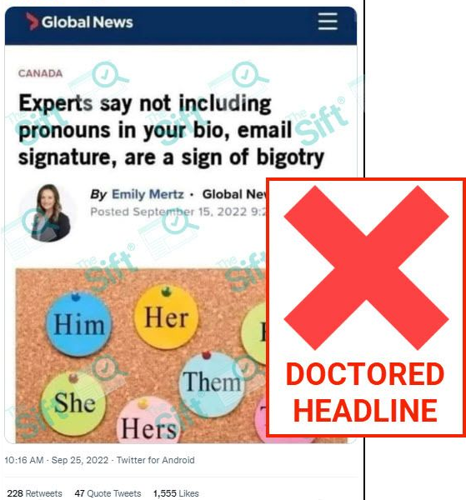
Imposter headline designed to spread outrage circulates online
October 3, 2022
https://rumors.newslit.org/impostor-headline- designed-to-spread-outrage-circulates-online/

Slide 7
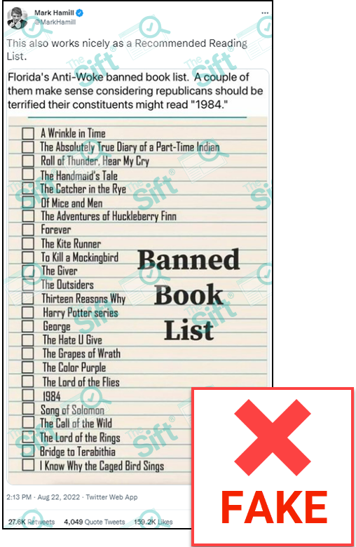
Viral list of banned books in Florida isn’t real
August 9, 2022
https://rumors.newslit.org/viral-list-of- banned-books-in-florida-isnt-real/

Slide 8
Social media forces users to oversimplify complex issues.
The simpler it is, the more attention it gets.

Slide 9
What contributed to gas prices going up?
Ransomware attack on the Colonial Pipeline halted production and created a fuel shortage
Rising demand as peak travel season approached
Pandemic
Worker shortages
War in Ukraine/Sanctions on Russia
Organization of the Petroleum Exporting Countries (OPEC)
Taxes (state and local)

Slide 10
Is social media all bad? No.
But we are all human (except for the bots)!

Slide 11
Social media has the opportunity to help us:
Create meaningful connection,
Share diverse perspectives and
Build strong communities.
All unhindered by geography and enhanced by technology that overcomes limitations.

Slide 12
Why does civility matter?
Promotes effective communication
Creates space for common ground
Creates opportunities for growth even amidst opposing viewpoints
Proves that we’re better than the bots!
Notes:
Create meaningful connection

Slide 13
Any questions?
Question the validity of content designed to get an emotional reaction
Question your own assumptions
Ask questions to find out more about someone’s viewpoint or story
Notes:
Share diverse perspectives

Slide 14
Our lives are a daily experiment.
Your attitudes and opinions are shaped by hundreds of factors over your lifetime.
Humans learn and change over time.
People make mistakes.
Notes:
Build strong communities.

Slide 15
Resources and links:
Aral, Sinan. How we can protect truth in the age of misinformation. TEDXCERN. Accessed October 3, 2022.
Eisenstat, Yaël. Dear Facebook, this is how you’re breaking democracy. TED 2020. Accessed October 4, 2022.
Gas station stickers “I did that!”. Know your meme. May 2022.
Imposter headline designed to spread outrage circulates online. News Literacy Project. October 3, 2022.
Media Bias Chart. AllSides. Accessed October 4, 2022.
Nicas, Jack. Why can’t the social networks stop fake accounts?. New York Times. Published Dec. 8, 2020. Updated Jan. 7, 2021
Teens’ social media habits and experiences. Pew Research Center. November 28, 2018.
The rise of left-wing, anti-Trump fake news. BBC. April 15, 2017.
Viral list of banned books in Florida isn’t real. News Literacy Project. August 9, 2022.

Slide 16
Opportunities for Students
Scholarships
Political Communication Concentration
Listen.Learn.Engage.
Practitioners in the Classroom
Student Leadership Academy
Stubblefield Institute Civility Club
Research & Internship Opportunities
Proud sponsor of the Shepherd University Speech and Debate Team

